Slide 1
Volatility Smiles
Chapter 19

Slide 2
Volatility Smile
A volatility smile shows, for options with a certain maturity, the variation of the implied volatility with the strike price
The volatility smile is the same whether calculated from European call options or European put options. (This follows from put-call parity.)
It is also approximately the same when calculated from American options

Slide 3
The Volatility Smile for Foreign Currency Options
(Figure 19.1, page 414)
Implied
Volatility
Strike
Price

Slide 4
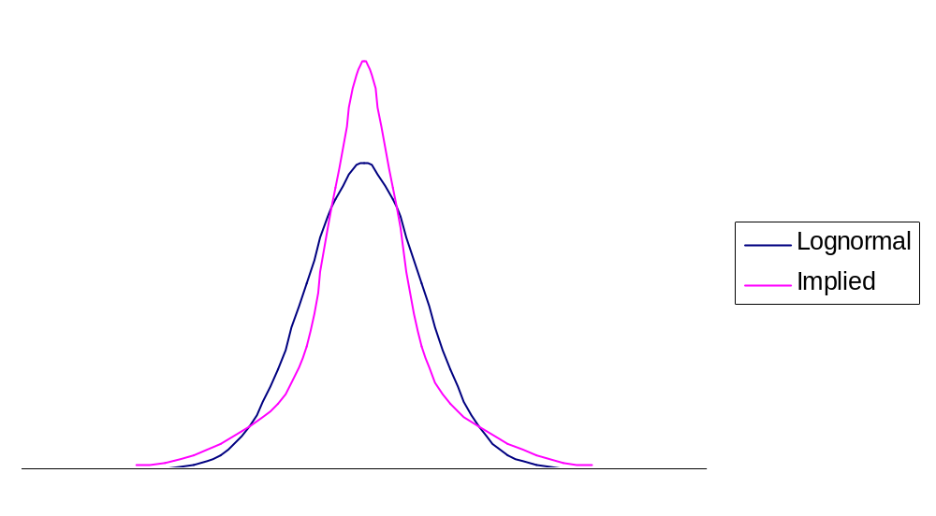
Implied Distribution for Foreign Currency Options

Slide 5
Properties of Implied Distribution for Foreign Currency Options
Both tails are heavier than the lognormal distribution
It is also “more peaked” than the normal distribution

Slide 6
Possible Causes of Volatility Smile for Foreign Currencies
Exchange rate exhibits jumps rather than continuous changes
Volatility of exchange rate is stochastic

Slide 7
Historical Analysis of Daily Exchange Rate Changes (10 exchange rates, 2005-2015; Table 19.1, page 415)
 | Real World (%) | Normal Model (%)
>1 SD | 23.32 | 31.73
>2SD | 4.67 | 4.55
>3SD | 1.30 | 0.27
>4SD | 0.49 | 0.01
>5SD | 0.24 | 0.00
>6SD | 0.13 | 0.00

Slide 8
The Volatility Smile for Equity Options (Figure 19.3, page 417)
Implied
Volatility
Strike
Price

Slide 9
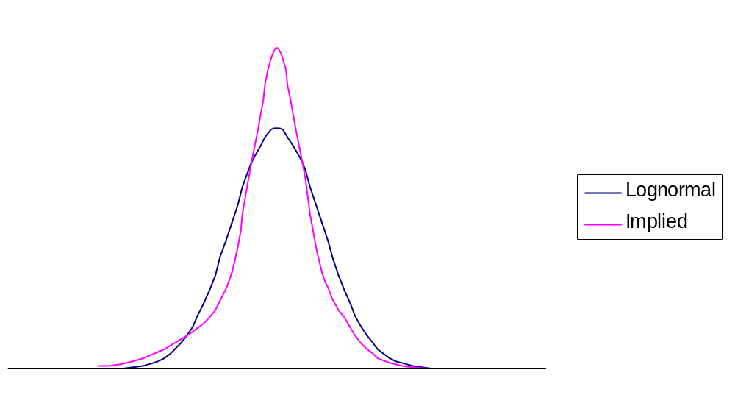
Implied Distribution for Equity Options

Slide 10
Properties of Implied Distribution for Equity Options
The left tail is heavier than the lognormal distribution
The right tail is less heavy than the lognormal distribution

Slide 11
Reasons for Smile in Equity Options
Leverage
Crashophobia

Slide 12
Other Volatility Smiles?
What is the volatility smile if
True distribution has a less heavy left tail and heavier right tail
True distribution has both a less heavy left tail and a less heavy right tail

Slide 13
Ways of Characterizing the Volatility Smiles
Plot implied volatility against K/S₀
Plot implied volatility against K/F₀
  Tarders may define an option as at-the-money when K equals the forward price, F₀, not when it equals the spot price S₀
Plot implied volatility against delta of the option
  Traders may define at-the money as a call with a delta of 0.5 or a put with a delta of −0.5. These are referred to as “50-delta options”

Slide 14
Volatility Term Structure
In addition to calculating a volatility smile, traders also calculate a volatility term structure
This shows the variation of implied volatility with the time to maturity of the option
The volatility term structure tends to be downward sloping when volatility is high and upward sloping when it is low

Slide 15
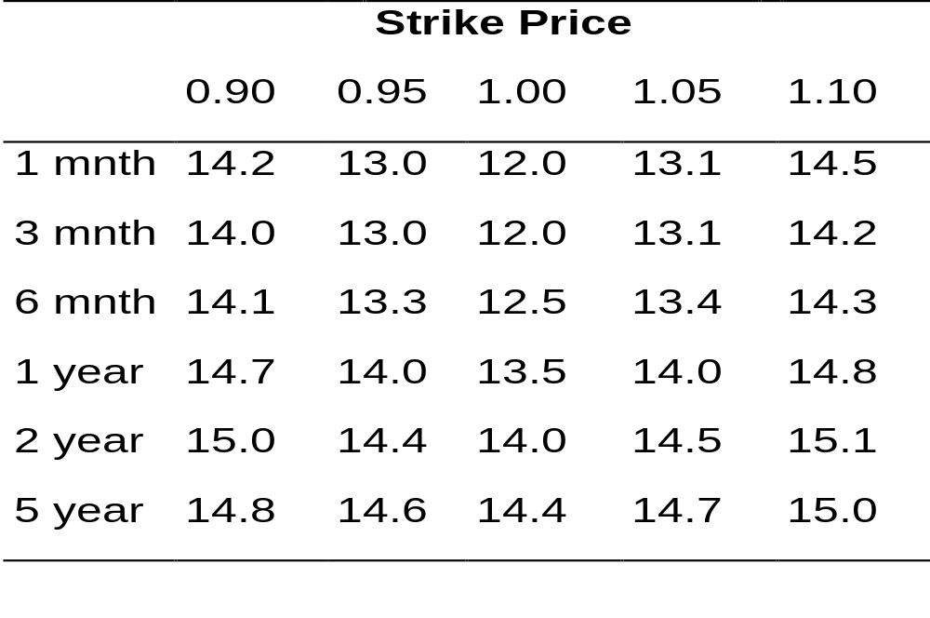
Example of a Volatility Surface
(Table 19.2, page 419)

Slide 16
The Impact of a Large Jump (pages 420 to 421)
At the money implied volatilities are higher that in-the-money or out-of-the-money options (so that the smile is a frown!)

